Slide 1


Modern Operating Systems
Fifth Edition
Chapter 2
Synchronization and Inter-Process Communication
Copyright © 2023, 2014, 2008 Pearson Education, Inc. All Rights Reserved
Notes:
If this PowerPoint presentation contains mathematical equations, you may need to check that your computer has the following installed:
1) MathType Plugin
2) Math Player (free versions available)
3) NVDA Reader (free versions available)

Slide 2
Synchronization and Inter-Process Communication (I P C)
Why?
Processes need some way to communicate:
To share data throughout the execution
No explicit cross-process sharing:
Data must be normally exchanged between processes
Processes need some way to synchronize:
To account for dependencies
To avoid they get in each other’s way
Also applies to multithreaded execution

Slide 3
Producer
while (true) { /* produce an item in next produced */
while (counter == BUFFER_SIZE) ;
/* do nothing */
buffer[in] = next_produced;
in = (in + 1) % BUFFER_SIZE;
counter++;
}

Slide 4
Consumer
while (true) {
while (counter == 0)
; /* do nothing */
next_consumed = buffer[out];
out = (out + 1) % BUFFER_SIZE;
counter--;
/* consume the item in next consumed */
}

Slide 5
Race Condition
counter++ could be implemented as register1 = counter register1 = register1 + 1 counter = register1
counter-- could be implemented as register2 = counter register2 = register2 - 1 counter = register2
Consider this execution interleaving with “count = 5” initially:
S0: producer execute register1 = counter {register1 = 5} S1: producer execute register1 = register1 + 1 {register1 = 6} S2: consumer execute register2 = counter {register2 = 5} S3: consumer execute register2 = register2 – 1 {register2 = 4} S4: producer execute counter = register1 {counter = 6 } S5: consumer execute counter = register2 {counter = 4}

Slide 6
Critical Regions
Requirements to avoid race conditions:
No two processes may be simultaneously inside their critical regions.
No assumptions may be made about speeds or the number of C P U s.
No process running outside its critical region may block other processes.
No process should have to wait forever to enter its critical region.

Slide 7
Critical Regions
Critical region: a code region with access to shared resources
No two processes may be simultaneously in their critical regions
No assumptions may be made about speeds or nr. of C P U s
No process running outside its critical region may block others
No process should have to wait forever to enter its critical region
(Non)solutions:
Disable interrupts: simply prevent that the C P U can be reallocated. Works for single-C P U systems only
Lock variables: guard critical regions with 0/1 variables. Races now occur on the lock variables themselves

Slide 8
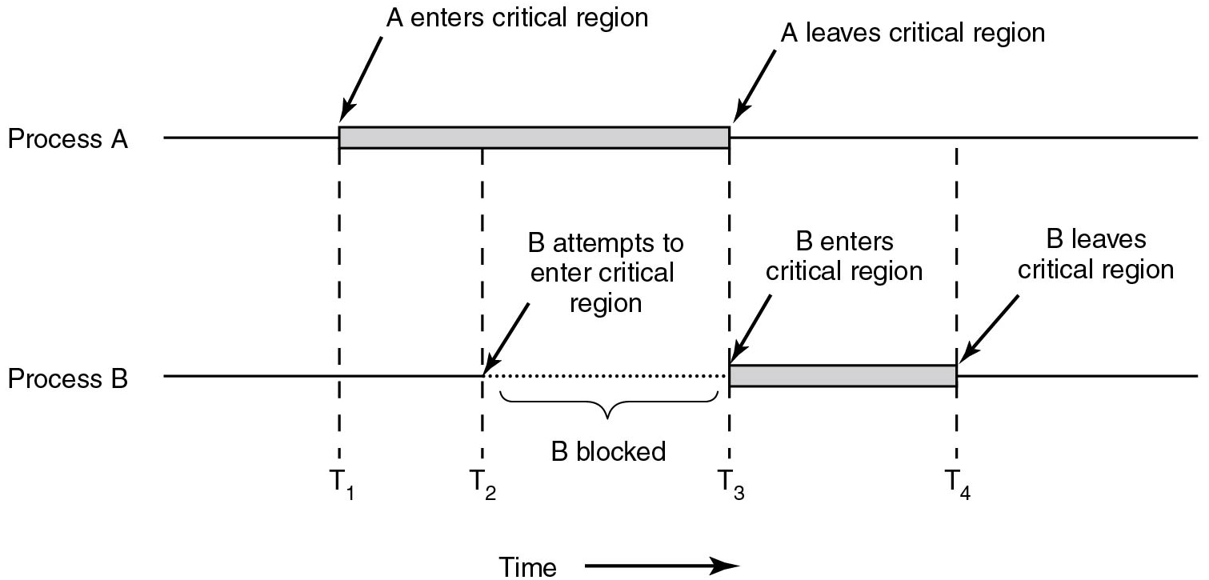
Critical Regions
Figure 2.22 Mutual exclusion using critical regions.
Notes:
Long Description:
The horizontal direction represents time. The image consists of two parts labeled Process "A" and Process B. A straight horizontal line labeled Process "A" has a horizontal rectangular block placed on it nearly at the center. An arrow "A" enters the critical region points to the left end of the block. Another arrow labeled "A" leaves the critical region points to the right end of the block. A straight horizontal line labeled Process B has a horizontal rectangular block placed on it exactly at the point where the rectangular block of Process "A" ends. An arrow labeled B enters the critical region points to the left end of the block. Another arrow labeled B leaves the critical region points to the right end of the block. There are four time intervals labeled T1, T2, T3, and T4 from left to right. The T1 time cycle is marked from where A enters the critical region, enters process B, and exits. The T2 time cycle is marked from where the Process "A" block, attempts to enter process B, and exits. The T3 time cycle is marked from where "A" leaves the critical region, enters process B. The T4 time cycle is marked from process A end of the line enters B where B leaves the critical region. The area between T2 and T3 is labeled B attempts to enter the critical region, line of Process B at this point is a dotted line and marked as B blocked.

Slide 9
Peterson’s Solution
Good algorithmic description of solving the problem
Two process solution
Assume that the load and store machine-language instructions are atomic; that is, cannot be interrupted
The two processes share two variables:
int turn;
Boolean flag[2]
The variable turn indicates whose turn it is to enter the critical section
The flag array is used to indicate if a process is ready to enter the critical section. flag[i] = true implies that process P_{i} is ready!

Slide 10
Algorithm for Process P_{i}
do {
flag[i] = true;
turn = j;
while (flag[j] && turn = = j);
critical section
flag[i] = false;
remainder section
} while (true);

Slide 11
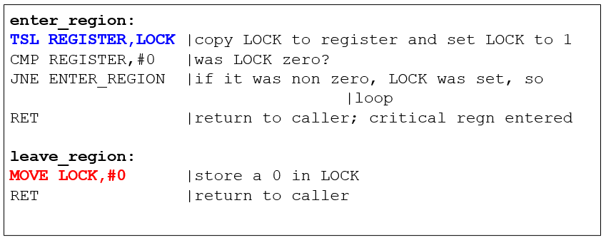
Mutual Exclusion with Busy Waiting: The T S L Instruction
Hardware-assisted solution to the mutual exclusion problem
Atomic test and set of a memory value
Spin until LOCK is acquired
Notes:
Long Description:
The instruction from top to bottom are as follows.
enter underscore region colon
T S L REGISTER comma LOCK vertical bar copy lock to register and set lock to 1
C M P REGISTER comma hashtag 0 vertical bar was lock zero question mark
J N E enter underscore region vertical bar if it was non zero comma lock was set comma so vertical bar loop
R E T vertical bar return to caller semicolon critical r e g n entered
leave underscore region colon
MOVE LOCK comma hashtag 0 vertical bar store a 0 in lock
R E T vertical bar return to caller

Slide 12
Producer-Consumer Problem
Paradigm for cooperating processes, producer process produces information that is consumed by a consumer process
unbounded-buffer places no practical limit on the size of the buffer
bounded-buffer assumes that there is a fixed buffer size

Slide 13
Bounded-Buffer – Shared-Memory Solution
Shared data
#define BUFFER_SIZE 10
typedef struct {
. . .
} item;
item buffer[BUFFER_SIZE];
int in = 0;
int out = 0;
Solution is correct, but can only use BUFFER_SIZE-1 elements

Slide 14
Bounded-Buffer – Producer
item next_produced;
while (true) {
/* produce an item in next produced */
while (((in + 1) % BUFFER_SIZE) == out)
; /* do nothing */
buffer[in] = next_produced;
in = (in + 1) % BUFFER_SIZE;
}

Slide 15
Bounded Buffer – Consumer
item next_consumed;
while (true) { while (in == out)
; /* do nothing */ next_consumed = buffer[out];
out = (out + 1) % BUFFER_SIZE;
/* consume the item in next consumed */
}

Slide 16
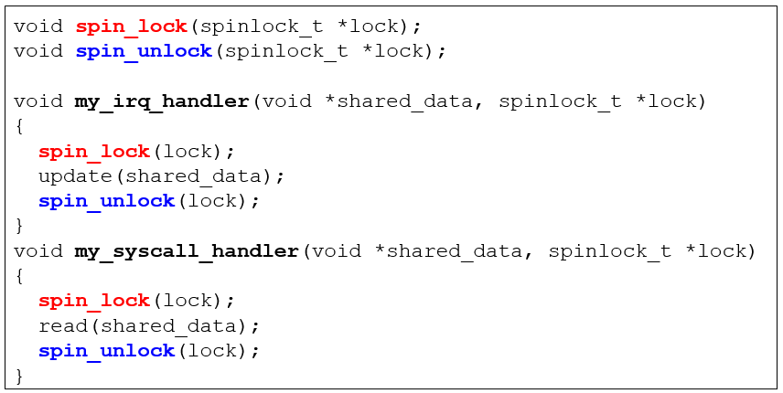
Spinlocks and Spinlock Problems
What would happen when we get an interrupt after the syscall handler has taken the lock?
Notes:
If irq is off when my_irq_handler is called, we have a deadlock
Long Description:
The code from top to bottom reads as follows.
void spin underscore lock left parenthesis spinlock, underscore, T asterisk lock left parenthesis, semicolon.
void spin underscore unlock left parenthesis spinlock, underscore, T asterisk lock left parenthesis, semicolon.
void my underscore I R Q under score handler, right parenthesis, void asterisk shared underscore data, comma spinlock, underscore T asterisk lock.
left brace
spin underscore lock left parenthesis lock right parenthesis semicolon
update left parenthesis shared underscore data right parenthesis semicolon
spin underscore unlock left parenthesis lock right parenthesis semicolon
right brace
void my underscore syscall underscore handler left parenthesis void asterisk shared underscore data comma spinlock underscore t asterisk lock
left brace
spin underscore lock left parenthesis lock right parenthesis semicolon
read left parenthesis shared underscore data right parenthesis semicolon
spin underscore unlock left parenthesis lock right parenthesis semicolon
right brace

Slide 17
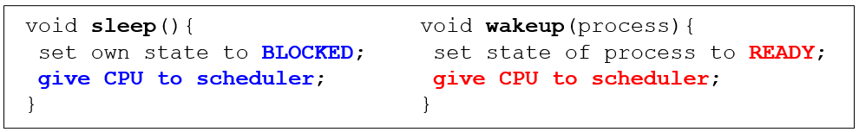
Avoiding Busy Waiting
The solutions so far let a process keep the C P U busy waiting until it can enter its critical region (spin lock)
Solution: let a process waiting to enter its critical region return the C P U to the scheduler voluntarily
Notes:
Long Description:
The code from top to bottom in the first set is as follows.
void sleep left parenthesis right parenthesis left brace
set own state to blocked semicolon
give C P U to scheduler
right brace
void wakeup left parenthesis process right parenthesis left brace
set state of process to ready semicolon
give C P U to scheduler
right brace

Slide 18
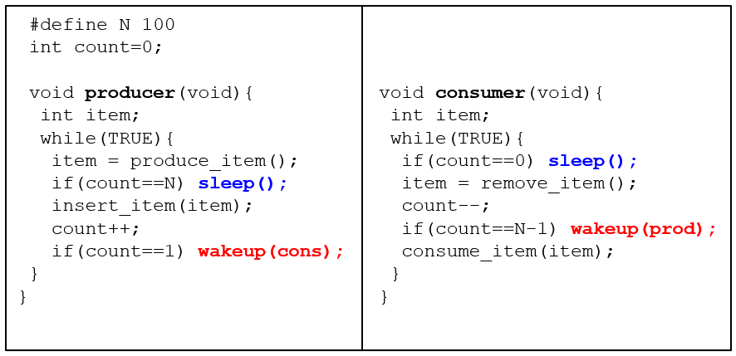
Producer-Consumer (1 of 4)
Notes:
Race condition. It can occur because access to count is unconstrained. As a consequence, the following situation could possibly occur. The buffer is empty and the consumer has just read count to see if it is 0. At that instant, the scheduler decides to stop running the consumer temporarily and start running the producer. The producer inserts an item in the buffer, increments count, and notices that it is now 1. Reasoning that count was just 0, and thus the consumer must be sleeping, the producer calls wakeup to wake the consumer up. Unfortunately, the consumer is not yet logically asleep, so the wakeup signal is lost. When the consumer next runs, it will test the value of count it previously read, find it to be 0, and go to sleep. Sooner or later the producer will fill up the buffer and also go to sleep. Both will sleep forever.
The essence of the problem here is that a wakeup sent to a process that is not (yet) sleeping is lost. If it were not lost, everything would work. A quick fix is to modify the rules to add a wakeup waiting bit to the picture. When a wakeup is sent to a process that is still awake, this bit is set. Later, when the process tries to go to sleep, if the wakeup waiting bit is on, it will be turned off, but the process will stay awake. The wakeup waiting bit is a piggy bank for storing wakeup signals.
The consumer clears the wakeup waiting bit in every iteration of the loop
Long Description:
The code from top to bottom is as follows.
hashtag define N 100
int count equals 0 semicolon
void producer left parenthesis void right parenthesis left brace
int item semicolon
while left parenthesis TRUE right parenthesis left
item equals produce underscore item left parenthesis right parenthesis semicolon
if left parenthesis count equals equals N right parenthesis sleep left parenthesis right parenthesis semicolon
insert underscore item left parenthesis item right parenthesis semicolon
count plus plus semicolon
if left parenthesis count equals equals 1 right parenthesis wakeup left parenthesis cons right parenthesis semicolon
right brace
right brace
void consumer left parenthesis void right parenthesis left brace
int item semicolon
while left parenthesis TRUE right parenthesis left brace
if left parenthesis count equals equals 0 right parenthesis sleep left parenthesis right parenthesis semicolon
item equals remove underscore item left parenthesis right parenthesis semicolon
count minus minus
if left parenthesis count equals equals N minus 1 right parenthesis wakeup left parenthesis p r o d right parenthesis semicolon
consume underscore item left parenthesis item right parenthesis semicolon
right brace
right brace

Slide 19
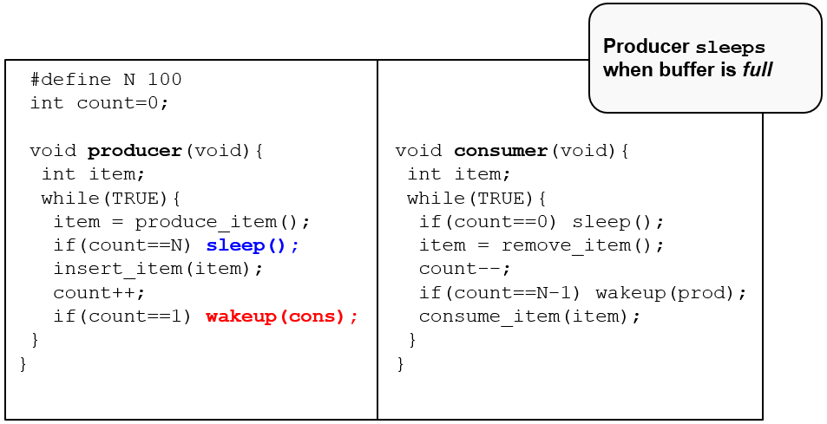
Producer-Consumer (2 of 4)
Notes:
Long Description:
The code from top to bottom is as follows.
hashtag define N 100
int count equals 0 semicolon
void producer left parenthesis void right parenthesis left brace
int item semicolon
while left parenthesis TRUE right parenthesis left
item equals produce underscore item left parenthesis right parenthesis semicolon
if left parenthesis count equals equals N right parenthesis sleep left parenthesis right parenthesis semicolon
insert underscore item left parenthesis item right parenthesis semicolon
count plus plus semicolon
if left parenthesis count equals equals 1 right parenthesis wakeup left parenthesis cons right parenthesis semicolon
right brace
right brace
void consumer left parenthesis void right parenthesis left brace
int item semicolon
while left parenthesis TRUE right parenthesis left brace
if left parenthesis count equals equals 0 right parenthesis sleep left parenthesis right parenthesis semicolon
item equals remove underscore item left parenthesis right parenthesis semicolon
count minus minus
if left parenthesis count equals equals N minus 1 right parenthesis wakeup left parenthesis p r o d right parenthesis semicolon
consume underscore item left parenthesis item right parenthesis semicolon
right brace
right brace
A insert below reads producer sleeps when buffer is full.

Slide 20
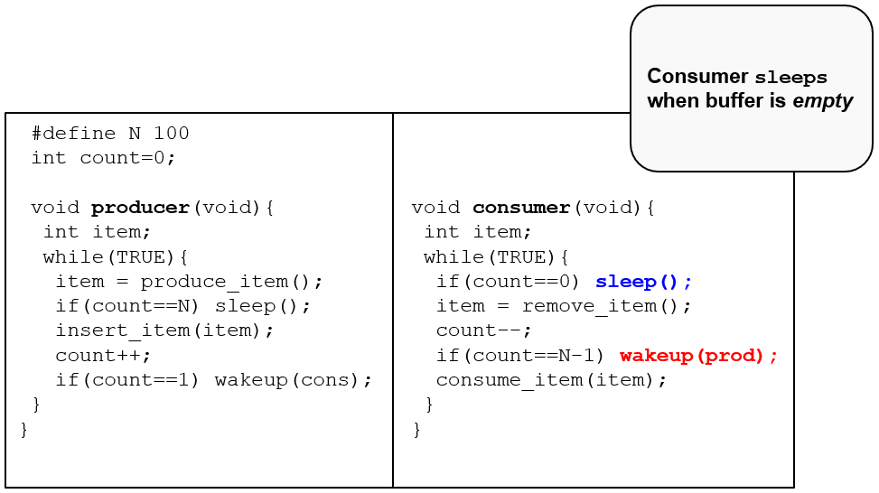
Producer-Consumer (3 of 4)
Notes:
Long Description:
The code from top to bottom is as follows.
hashtag define N 100
int count equals 0 semicolon
void producer left parenthesis void right parenthesis left brace
int item semicolon
while left parenthesis TRUE right parenthesis left
item equals produce underscore item left parenthesis right parenthesis semicolon
if left parenthesis count equals equals N right parenthesis sleep left parenthesis right parenthesis semicolon
insert underscore item left parenthesis item right parenthesis semicolon
count plus plus semicolon
if left parenthesis count equals equals 1 right parenthesis wakeup left parenthesis cons right parenthesis semicolon
right brace
right brace
void consumer left parenthesis void right parenthesis left brace
int item semicolon
while left parenthesis TRUE right parenthesis left brace
if left parenthesis count equals equals 0 right parenthesis sleep left parenthesis right parenthesis semicolon
item equals remove underscore item left parenthesis right parenthesis semicolon
count minus minus
if left parenthesis count equals equals N minus 1 right parenthesis wakeup left parenthesis p r o d right parenthesis semicolon
consume underscore item left parenthesis item right parenthesis semicolon
right brace
right brace
A insert below reads consumer sleeps when buffer is empty.

Slide 21
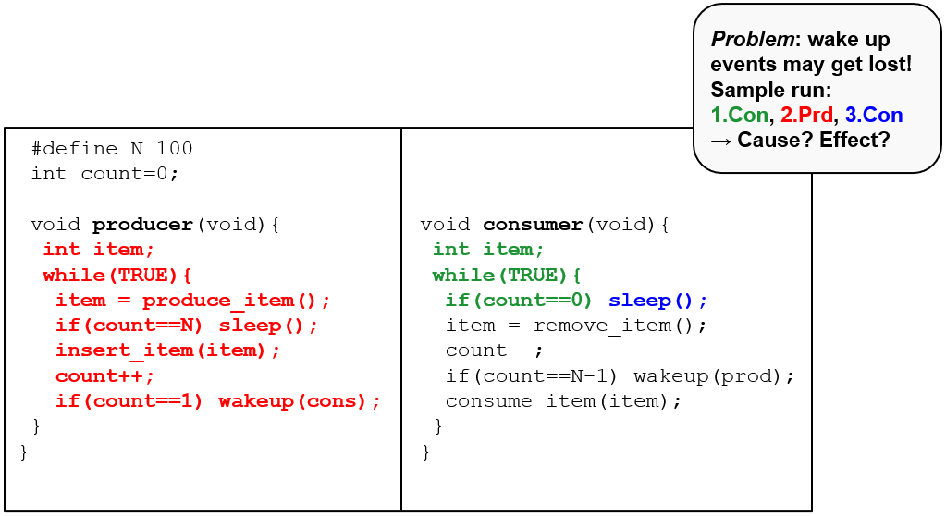
Producer-Consumer (4 of 4)
Notes:
Long Description:
The code from top to bottom is as follows.
hashtag define N 100
int count equals 0 semicolon
void producer left parenthesis void right parenthesis left brace
int item semicolon
while left parenthesis TRUE right parenthesis left
item equals produce underscore item left parenthesis right parenthesis semicolon
if left parenthesis count equals equals N right parenthesis sleep left parenthesis right parenthesis semicolon
insert underscore item left parenthesis item right parenthesis semicolon
count plus plus semicolon
if left parenthesis count equals equals 1 right parenthesis wakeup left parenthesis cons right parenthesis semicolon
right brace
right brace
void consumer left parenthesis void right parenthesis left brace
int item semicolon
while left parenthesis TRUE right parenthesis left brace
if left parenthesis count equals equals 0 right parenthesis sleep left parenthesis right parenthesis semicolon
item equals remove underscore item left parenthesis right parenthesis semicolon
count minus minus
if left parenthesis count equals equals N minus 1 right parenthesis wakeup left parenthesis p r o d right parenthesis semicolon
consume underscore item left parenthesis item right parenthesis semicolon
right brace
right brace
A insert below reads problem colon wake up events may get lost exclamation mark Sample run colon 1 dot con comma 2 dot P r d comma 3 dot C o n right arrow cause question mark effect question mark.

Slide 22
Mutex Locks
Previous solutions are complicated and generally inaccessible to application programmers
OS designers build software tools to solve critical section problem
Simplest is mutex lock
Protect a critical section by first acquire() a lock then release() the lock
Boolean variable indicating if lock is available or not
Calls to acquire() and release() must be atomic
Usually implemented via hardware atomic instructions
But this solution requires busy waiting
This lock therefore called a spinlock

Slide 23
acquire() and release()
acquire() { while (!available)
; /* busy wait */
available = false;;
}
release() {
available = true;
}
do {
acquire lock
critical section
release lock
remainder section
} while (true);

Slide 24
Mutexes in Pthreads
Thread Call | Description
pthread_mutex_init | Create a mutex
pthread_mutex_destroy | Destroy an existing mutex
pthread _mutex_lock | Acquire a lock or block
pthread_mutex_trylock | Acquire a lock or fail
pthread_mutex_unlock | Release a lock
Figure 2.31 Some of the Pthreads calls relating to mutexes.

Slide 25
Mutexes in Pthreads
Thread Call | Description
pthread_cond_init | Create a condition variable
pthread_cond_destroy | Destroy a condition variable
pthread _cond_wait | Block waiting for a signal
pthread_cond_signal | Signal another thread and wake it up
pthread_cond_broadcast | Signal multiple threads and wake all of them
Figure 2.32 Some of the Pthreads calls relating to condition variables.

Slide 26
Semaphore
Synchronization tool that provides more sophisticated ways (than Mutex locks) for process to synchronize their activities.
Semaphore S – integer variable
Can only be accessed via two indivisible (atomic) operations
wait() and signal()
Originally called P() and V()
Definition of the wait() operation
wait(S) {
while (S <= 0)
; // busy wait
S--;
}
Definition of the signal() operation
signal(S) {
S++;
}

Slide 27
Semaphore Usage
Counting semaphore – integer value can range over an unrestricted domain
Binary semaphore – integer value can range only between 0 and 1
Same as a mutex lock
Can solve various synchronization problems
Consider P₁ and P₂ that require S₁ to happen before S₂
Create a semaphore “synch” initialized to 0
P1:
S₁;
signal(synch);
P2:
wait(synch);
S₂;
Can implement a counting semaphore S as a binary semaphore

Slide 28
Semaphore Implementation
Must guarantee that no two processes can execute the wait() and signal() on the same semaphore at the same time
Thus, the implementation becomes the critical section problem where the wait and signal code are placed in the critical section
Could now have busy waiting in critical section implementation
But implementation code is short
Little busy waiting if critical section rarely occupied
Note that applications may spend lots of time in critical sections and therefore this is not a good solution

Slide 29
Semaphore Implementation with no Busy waiting
With each semaphore there is an associated waiting queue
Each entry in a waiting queue has two data items:
value (of type integer)
pointer to next record in the list
Two operations:
block – place the process invoking the operation on the appropriate waiting queue
wakeup – remove one of processes in the waiting queue and place it in the ready queue
typedef struct{
int value;
struct process *list;
} semaphore;

Slide 30
Implementation with no Busy waiting (Cont.)
wait(semaphore *S) {
S->value--;
if (S->value < 0) { add this process to S->list;
block();
}
}
signal(semaphore *S) {
S->value++;
if (S->value <= 0) { remove a process P from S->list;
wakeup(P);
}
}

Slide 31
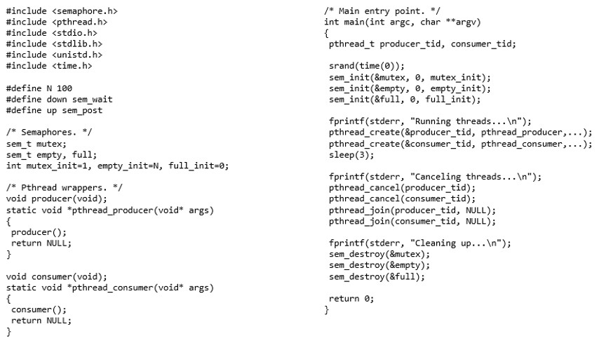
Full Example on Linux
Notes:
Long Description:
The code is as follows: hash include open angle bracket semaphore dot h close angle bracket; hash include open angle bracket pthread dot h close angle bracket; hash include open angle bracket s t d i o dot h close angle bracket; hash include open angle bracket s t d lib dot h close angle bracket; hash include open angle bracket uni s t d dot h close angle bracket; hash include open angle bracket time dot h close angle bracket; hash define N 100; hash define down sem underscore wait; hash define up sem underscore post; front slash asterisk Semaphores dot Asterisk front slash; sem underscore t mutex semicolon; sem underscore t empty, full semicolon; int mutex underscore init equals 1, empty underscore init equals N, full underscore init equals 0 semicolon; front slash asterisk Pthread wrappers dot Asterisk front slash; void producer open round bracket void close round bracket semicolon; static void asterisk pthread underscore producer open round bracket void asterisk args close round bracket; open curly bracket; producer open round bracket close round bracket semicolon; return NULL semicolon; close curly bracket; void consumer open round bracket void close round bracket semicolon; static void asterisk pthread underscore consumer open round bracket void asterisk args close round bracket; open curly bracket; consumer open round bracket close round bracket semicolon; return NULL semicolon; close curly bracket; forward slash asterisk Main entry point. Asterisk forward slash; int main open round bracket int arg c comma char asterisk asterisk arg v close round bracket; open curly bracket; pthread underscore t producer underscore tid comma consumer underscore tid semicolon; srand open round bracket time open round bracket 0 close round bracket close round bracket semicolon; sem underscore init open round bracket ampersand mutex comma 0 comma mutex underscore init close round bracket semicolon; sem underscore init open round bracket ampersand empty comma 0 comma empty underscore init close round bracket semicolon; sem underscore init open round bracket ampersand full comma 0 comma full underscore init close round bracket semicolon; f print f open round bracket stderr comma open quote Running threads ellipsis forward slash n close quote close round bracket semicolon; pthread underscore create open round bracket ampersand producer underscore tid comma pthread underscore producer comma ellipsis close round bracket semicolon; pthread underscore create open round bracket ampersand consumer underscore tid comma pthread underscore consumer comma ellipsis close round bracket semicolon; sleep open round bracket 3 close round bracket semicolon; f print f open round bracket stderr comma open quote Canceling threads ellipsis forward slash n close quote close round bracket semicolon; pthread underscore cancel open round bracket producer underscore tid close round bracket semicolon; pthread underscore cancel open round bracket consumer underscore tid close round bracket semicolon; pthread underscore join open round bracket producer underscore tid comma NULL close round bracket semicolon; pthread underscore join open round bracket consumer underscore tid comma NULL close round bracket semicolon; f print f open round bracket stderr comma close quote Cleaning up ellipsis forward slash n close quote close round bracket semicolon; sem underscore destroy open round bracket ampersand mutex close round bracket semicolon; sem underscore destroy open round bracket ampersand empty close round bracket semicolon; sem underscore destroy open round bracket ampersand full close round bracket semicolon; return 0 semicolon; close curly bracket.

Slide 32
Readers-Writers Problem
A data set is shared among a number of concurrent processes
Readers – only read the data set; they do not perform any updates
Writers – can both read and write
Problem – allow multiple readers to read at the same time
Only one single writer can access the shared data at the same time
Several variations of how readers and writers are considered – all involve some form of priorities
Shared Data
Data set
Semaphore rw_mutex initialized to 1
Semaphore mutex initialized to 1
Integer read_count initialized to 0

Slide 33
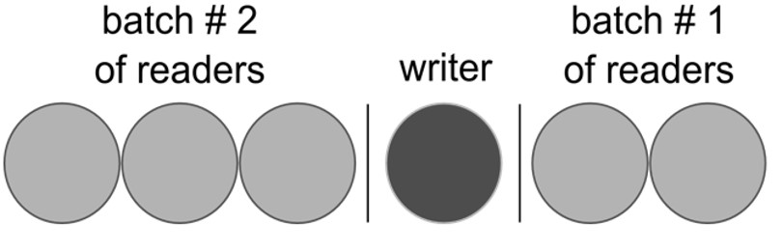
Readers/Writers
Idea: Build a queue of readers and writers
Let several readers in at the same time
Allow 1 writer when no readers are active
How long may the writer have to wait?
Notes:
Long Description:
The circles are divided into groups of three, one, and two by vertical bars. The first three circles are labeled batch hashtag 2 of readers. The fourth circle is labeled the writer. The last two are labeled as the batch hashtag 1 of readers.

Slide 34
Readers-Writers Problem (Cont.)
The structure of a writer process
do { wait(rw_mutex);
... /* writing is performed */
...
signal(rw_mutex);
} while (true);

Slide 35
Readers-Writers Problem (Cont.)
The structure of a reader process
do { wait(mutex); read_count++; if (read_count == 1)
wait(rw_mutex);
signal(mutex);
... /* reading is performed */
...
wait(mutex); read count--; if (read_count == 0)
signal(rw_mutex);
signal(mutex);
} while (true);

Slide 36
Monitors
Semaphores have been heavily criticized for the chaos they can introduce
Monitors: more structured approach towards process synchronization:
Serialize the procedure calls on a given module
Use condition variables to wait / signal processes
Monitors require language support
Popular in managed languages, e.g., Java:
Synchronized methods / blocks
Wait, notify, notifyall primitives

Slide 37
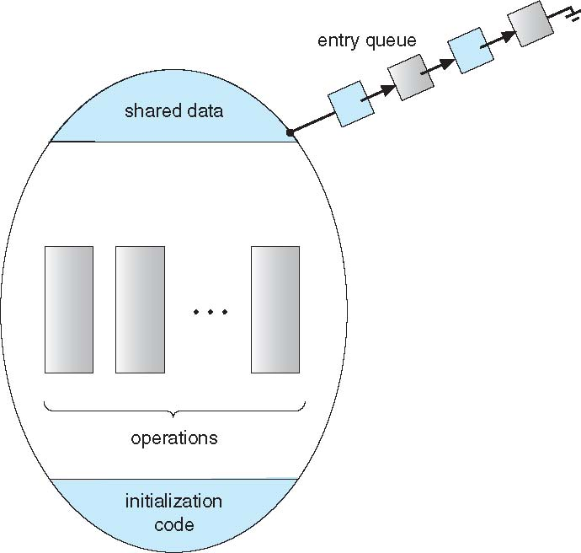
Schematic view of a Monitor

Slide 38
Condition Variables
condition x, y;
Two operations are allowed on a condition variable:
x.wait() – a process that invokes the operation is suspended until x.signal()
x.signal() – resumes one of processes (if any) that invoked x.wait()
If no x.wait() on the variable, then it has no effect on the variable

Slide 39
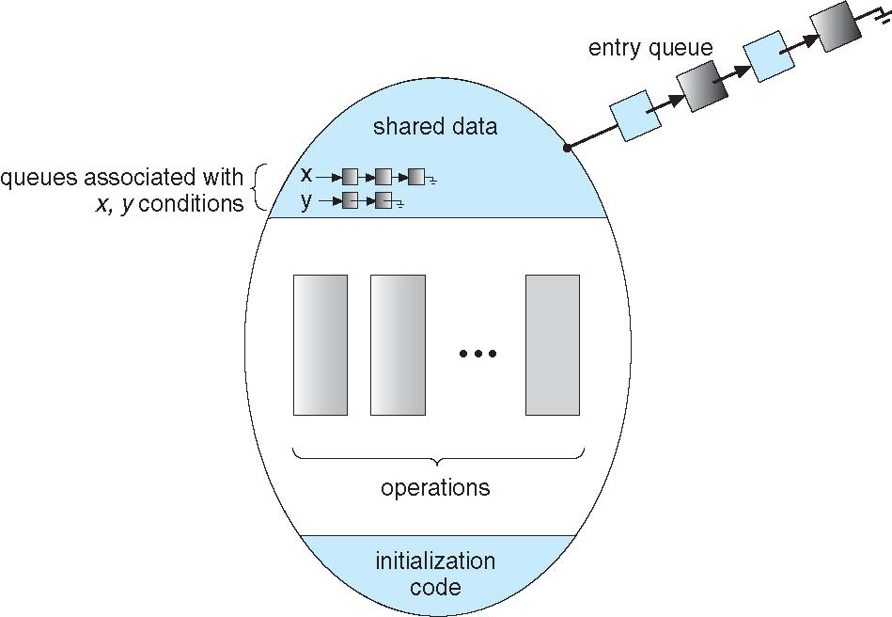
Monitor with Condition Variables

Slide 40
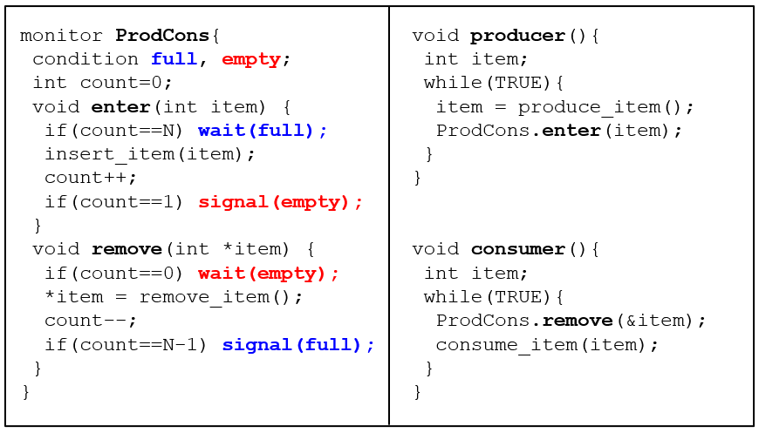
Monitors: Producer-Consumer (1 of 5)
Notes:
compiler responsible for adding mutex (so less likely to go wrong)
Long Description:
The code from top to bottom is as follows.
monitor ProdCons left brace
condition full, empty semicolon
int count equals 0 semicolon
void enter open parenthesis int item close parenthesis left brace
if right parenthesis count equal equals N right parenthesis wait left parenthesis full right parenthesis semicolon
insert underscore item left parenthesis item right parenthesis semicolon
count plus plus semicolon
if left parenthesis count equals equals 1 right parenthesis signal left parenthesis empty right parenthesis semicolon
right brace
void remove left parenthesis int asterisk item right parenthesis left brace
if left parenthesis count equals equals 0 right parenthesis wait left parenthesis empty right parenthesis semicolon
asterisk item equals remove underscore item left parenthesis right parenthesis semicolon
count minus minus
if left parenthesis count equals equals N minus 1 right parenthesis signal left parenthesis full right parenthesis semicolon
right brace
right brace
void producer left parenthesis right parenthesis left brace
int item semicolon
while left parenthesis TRUE right parenthesis left brace
item equals produce underscore item left parenthesis right parenthesis semicolon
ProdCons dot enter left parenthesis item right parenthesis semicolon
right brace
right brace
void consumer left parenthesis right parenthesis left brace
int item semicolon
while left parenthesis TRUE right parenthesis left brace
ProdCons dot remove left parenthesis ampersand item right parenthesis semicolon
consume underscore item left parenthesis item right parenthesis semicolon
right brace

Slide 41
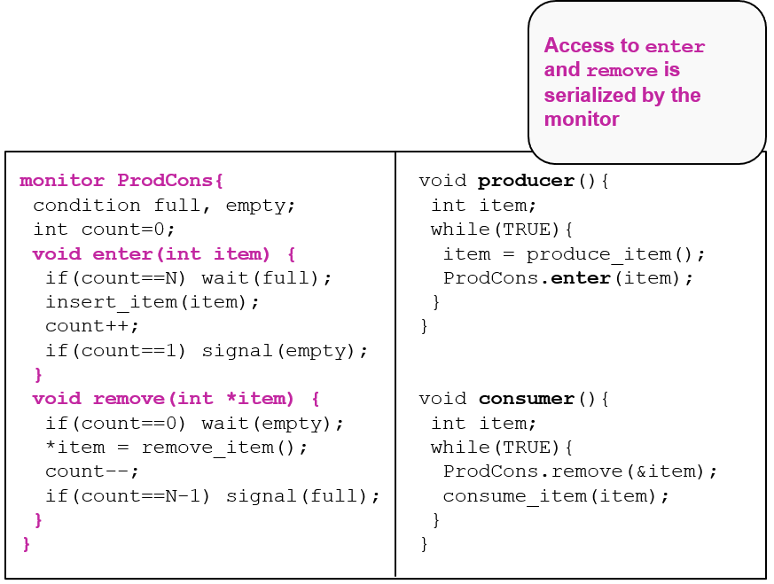
Monitors: Producer-Consumer (2 of 5)
Notes:
Long Description:
The code from top to bottom is as follows.
monitor ProdCons left brace
condition full, empty semicolon
int count equals 0 semicolon
void enter open parenthesis int item close parenthesis left brace
if right parenthesis count equal equals N right parenthesis wait left parenthesis full right parenthesis semicolon
insert underscore item left parenthesis item right parenthesis semicolon
count plus plus semicolon
if left parenthesis count equals equals 1 right parenthesis signal left parenthesis empty right parenthesis semicolon
right brace
void remove left parenthesis int asterisk item right parenthesis left brace
if left parenthesis count equals equals 0 right parenthesis wait left parenthesis empty right parenthesis semicolon
asterisk item equals remove underscore item left parenthesis right parenthesis semicolon
count minus minus
if left parenthesis count equals equals N minus 1 right parenthesis signal left parenthesis full right parenthesis semicolon
right brace
right brace
void producer left parenthesis right parenthesis left brace
int item semicolon
while left parenthesis TRUE right parenthesis left brace
item equals produce underscore item left parenthesis right parenthesis semicolon
ProdCons dot enter left parenthesis item right parenthesis semicolon
right brace
right brace
void consumer left parenthesis right parenthesis left brace
int item semicolon
while left parenthesis TRUE right parenthesis left brace
ProdCons dot remove left parenthesis ampersand item right parenthesis semicolon
consume underscore item left parenthesis item right parenthesis semicolon
right brace
An excerpt on the top right corner reads access to enter and remove is serialized by the monitor.

Slide 42
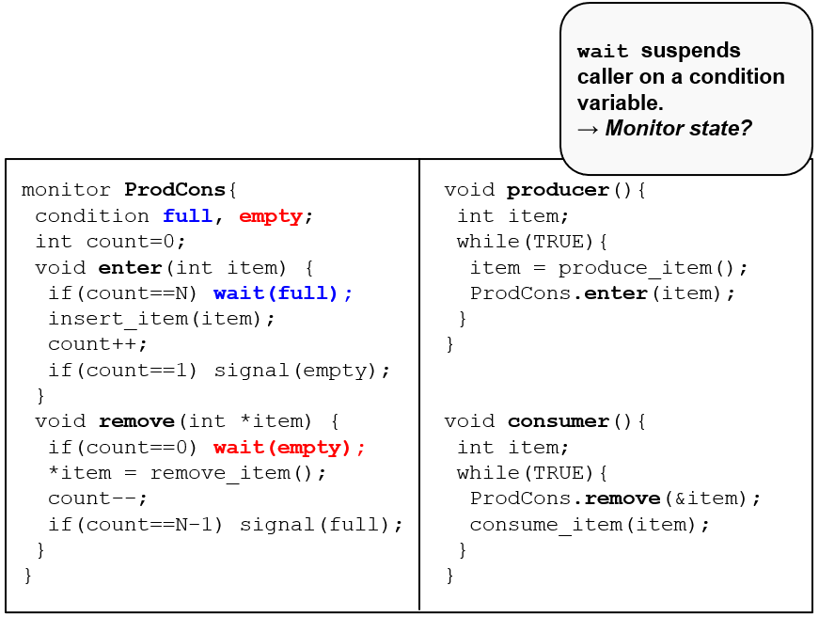
Monitors: Producer-Consumer (3 of 5)
Notes:
Long Description:
The code from top to bottom is as follows.
monitor ProdCons left brace
condition full, empty semicolon
int count equals 0 semicolon
void enter open parenthesis int item close parenthesis left brace
if right parenthesis count equal equals N right parenthesis wait left parenthesis full right parenthesis semicolon
insert underscore item left parenthesis item right parenthesis semicolon
count plus plus semicolon
if left parenthesis count equals equals 1 right parenthesis signal left parenthesis empty right parenthesis semicolon
right brace
void remove left parenthesis int asterisk item right parenthesis left brace
if left parenthesis count equals equals 0 right parenthesis wait left parenthesis empty right parenthesis semicolon
asterisk item equals remove underscore item left parenthesis right parenthesis semicolon
count minus minus
if left parenthesis count equals equals N minus 1 right parenthesis signal left parenthesis full right parenthesis semicolon
right brace
right brace
void producer left parenthesis right parenthesis left brace
int item semicolon
while left parenthesis TRUE right parenthesis left brace
item equals produce underscore item left parenthesis right parenthesis semicolon
ProdCons dot enter left parenthesis item right parenthesis semicolon
right brace
right brace
void consumer left parenthesis right parenthesis left brace
int item semicolon
while left parenthesis TRUE right parenthesis left brace
ProdCons dot remove left parenthesis ampersand item right parenthesis semicolon
consume underscore item left parenthesis item right parenthesis semicolon
right brace
An excerpt on the top right corner reads wait suspends caller on a condition variable right arrow motor state question mark.

Slide 43
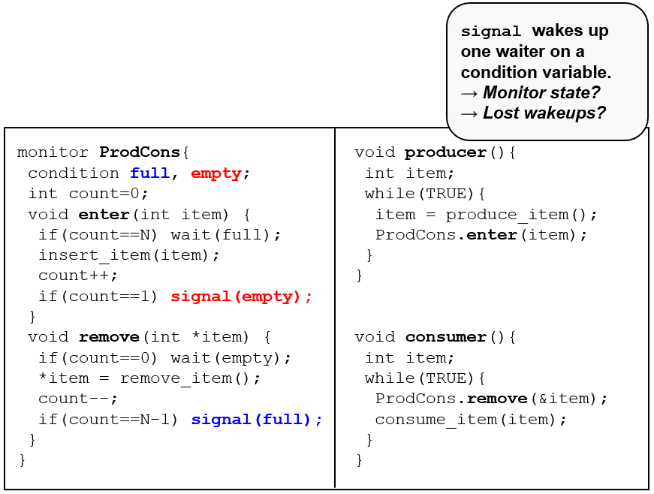
Monitors: Producer-Consumer (4 of 5)
Notes:
Long Description:
The code from top to bottom is as follows.
monitor ProdCons left brace
condition full, empty semicolon
int count equals 0 semicolon
void enter open parenthesis int item close parenthesis left brace
if right parenthesis count equal equals N right parenthesis wait left parenthesis full right parenthesis semicolon
insert underscore item left parenthesis item right parenthesis semicolon
count plus plus semicolon
if left parenthesis count equals equals 1 right parenthesis signal left parenthesis empty right parenthesis semicolon
right brace
void remove left parenthesis int asterisk item right parenthesis left brace
if left parenthesis count equals equals 0 right parenthesis wait left parenthesis empty right parenthesis semicolon
asterisk item equals remove underscore item left parenthesis right parenthesis semicolon
count minus minus
if left parenthesis count equals equals N minus 1 right parenthesis signal left parenthesis full right parenthesis semicolon
right brace
right brace
void producer left parenthesis right parenthesis left brace
int item semicolon
while left parenthesis TRUE right parenthesis left brace
item equals produce underscore item left parenthesis right parenthesis semicolon
ProdCons dot enter left parenthesis item right parenthesis semicolon
right brace
right brace
void consumer left parenthesis right parenthesis left brace
int item semicolon
while left parenthesis TRUE right parenthesis left brace
ProdCons dot remove left parenthesis ampersand item right parenthesis semicolon
consume underscore item left parenthesis item right parenthesis semicolon
right brace
An excerpt on the top right corner reads signal wakes up one waiter on a condition variable. Right arrow monitor state question mark right arrow lost wakeups question mark.

Slide 44
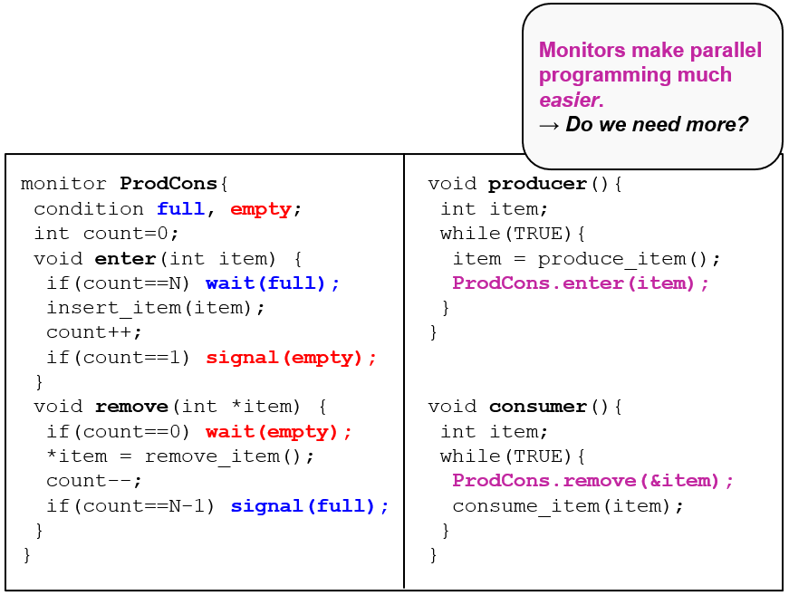
Monitors: Producer-Consumer (5 of 5)
Notes:
Long Description:
The code from top to bottom is as follows.
monitor ProdCons left brace
condition full, empty semicolon
int count equals 0 semicolon
void enter open parenthesis int item close parenthesis left brace
if right parenthesis count equal equals N right parenthesis wait left parenthesis full right parenthesis semicolon
insert underscore item left parenthesis item right parenthesis semicolon
count plus plus semicolon
if left parenthesis count equals equals 1 right parenthesis signal left parenthesis empty right parenthesis semicolon
right brace
void remove left parenthesis int asterisk item right parenthesis left brace
if left parenthesis count equals equals 0 right parenthesis wait left parenthesis empty right parenthesis semicolon
asterisk item equals remove underscore item left parenthesis right parenthesis semicolon
count minus minus
if left parenthesis count equals equals N minus 1 right parenthesis signal left parenthesis full right parenthesis semicolon
right brace
right brace
void producer left parenthesis right parenthesis left brace
int item semicolon
while left parenthesis TRUE right parenthesis left brace
item equals produce underscore item left parenthesis right parenthesis semicolon
ProdCons dot enter left parenthesis item right parenthesis semicolon
right brace
right brace
void consumer left parenthesis right parenthesis left brace
int item semicolon
while left parenthesis TRUE right parenthesis left brace
ProdCons dot remove left parenthesis ampersand item right parenthesis semicolon
consume underscore item left parenthesis item right parenthesis semicolon
right brace
An excerpt on the top right corner reads monitors make parallel programming much easier right arrow do we need more question mark.

Slide 45
Interprocess Communication
Processes within a system may be independent or cooperating
Cooperating process can affect or be affected by other processes, including sharing data
Reasons for cooperating processes:
Information sharing
Computation speedup
Modularity
Convenience
Cooperating processes need interprocess communication (IPC)
Two models of IPC
Shared memory
Message passing

Slide 46
Communications Models
(a) Message passing. (b) shared memory.

Slide 47
Cooperating Processes
Independent process cannot affect or be affected by the execution of another process
Cooperating process can affect or be affected by the execution of another process
Advantages of process cooperation
Information sharing
Computation speed-up
Modularity
Convenience

Slide 48
Interprocess Communication – Shared Memory
An area of memory shared among the processes that wish to communicate
The communication is under the control of the users processes not the operating system.
Major issues is to provide mechanism that will allow the user processes to synchronize their actions when they access shared memory.

Slide 49
Interprocess Communication – Message Passing
Mechanism for processes to communicate and to synchronize their actions
Message system – processes communicate with each other without resorting to shared variables
IPC facility provides two operations:
send(message)
receive(message)
The message size is either fixed or variable

Slide 50
Message Passing (Cont.)
If processes P and Q wish to communicate, they need to:
Establish a communication link between them
Exchange messages via send/receive
Implementation issues:
How are links established?
Can a link be associated with more than two processes?
How many links can there be between every pair of communicating processes?
What is the capacity of a link?
Is the size of a message that the link can accommodate fixed or variable?
Is a link unidirectional or bi-directional?

Slide 51
Message Passing (Cont.)
Implementation of communication link
Physical:
Shared memory
Hardware bus
Network
Logical:
Direct or indirect
Synchronous or asynchronous
Automatic or explicit buffering

Slide 52
Examples of IPC Systems - POSIX
POSIX Shared Memory
Process first creates shared memory segment shm_fd = shm_open(name, O CREAT | O RDWR, 0666);
Also used to open an existing segment to share it
Set the size of the object
ftruncate(shm fd, 4096);
Now the process could write to the shared memory
sprintf(shared memory, "Writing to shared memory");

Slide 53
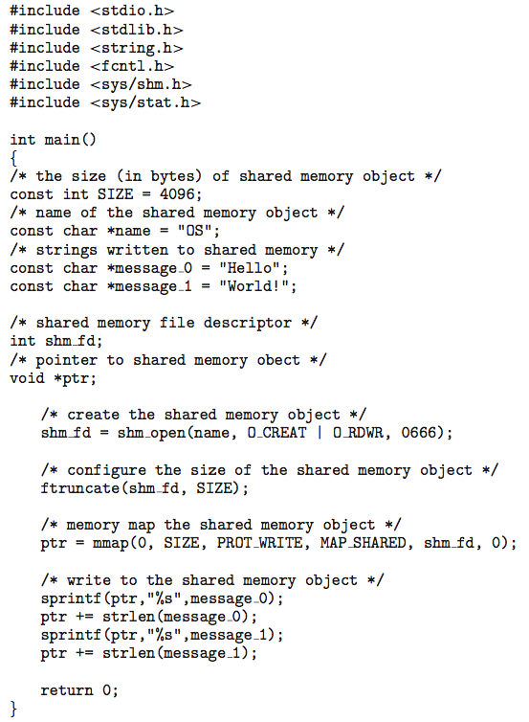
IPC POSIX Producer

Slide 54
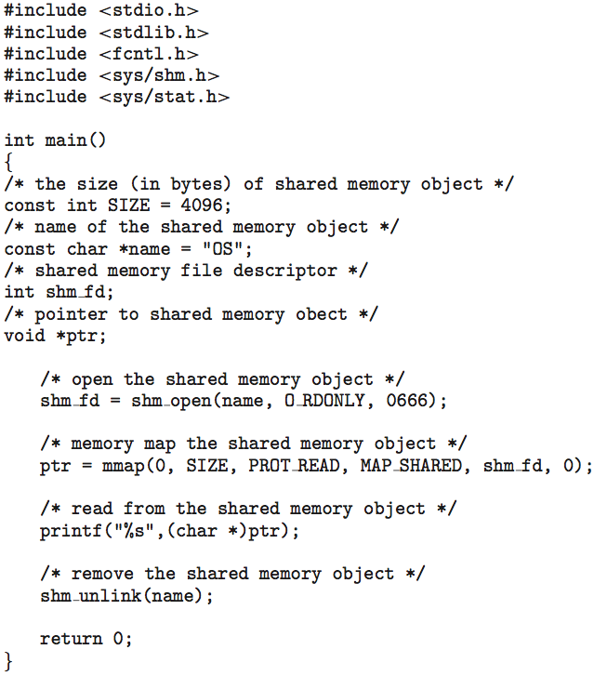
IPC POSIX Consumer

Slide 55
Sockets
A socket is defined as an endpoint for communication
Concatenation of IP address and port – a number included at start of message packet to differentiate network services on a host
The socket 161.25.19.8:1625 refers to port 1625 on host 161.25.19.8
Communication consists between a pair of sockets
All ports below 1024 are well known, used for standard services
Special IP address 127.0.0.1 (loopback) to refer to system on which process is running

Slide 56
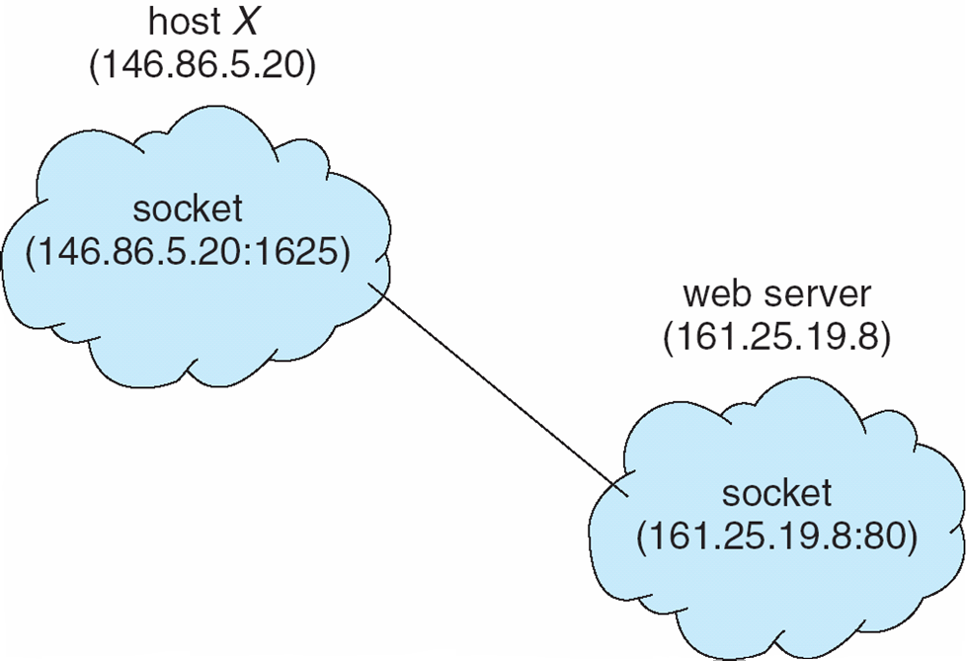
Socket Communication

Slide 57
Remote Procedure Calls
Remote procedure call (RPC) abstracts procedure calls between processes on networked systems
Again uses ports for service differentiation
Stubs – client-side proxy for the actual procedure on the server
The client-side stub locates the server and marshalls the parameters
The server-side stub receives this message, unpacks the marshalled parameters, and performs the procedure on the server
On Windows, stub code compile from specification written in Microsoft Interface Definition Language (MIDL)

Slide 58
Remote Procedure Calls (Cont.)
Data representation handled via External Data Representation (XDL) format to account for different architectures
Big-endian and little-endian
Remote communication has more failure scenarios than local
Messages can be delivered exactly once rather than at most once
OS typically provides a rendezvous (or matchmaker) service to connect client and server

Slide 59
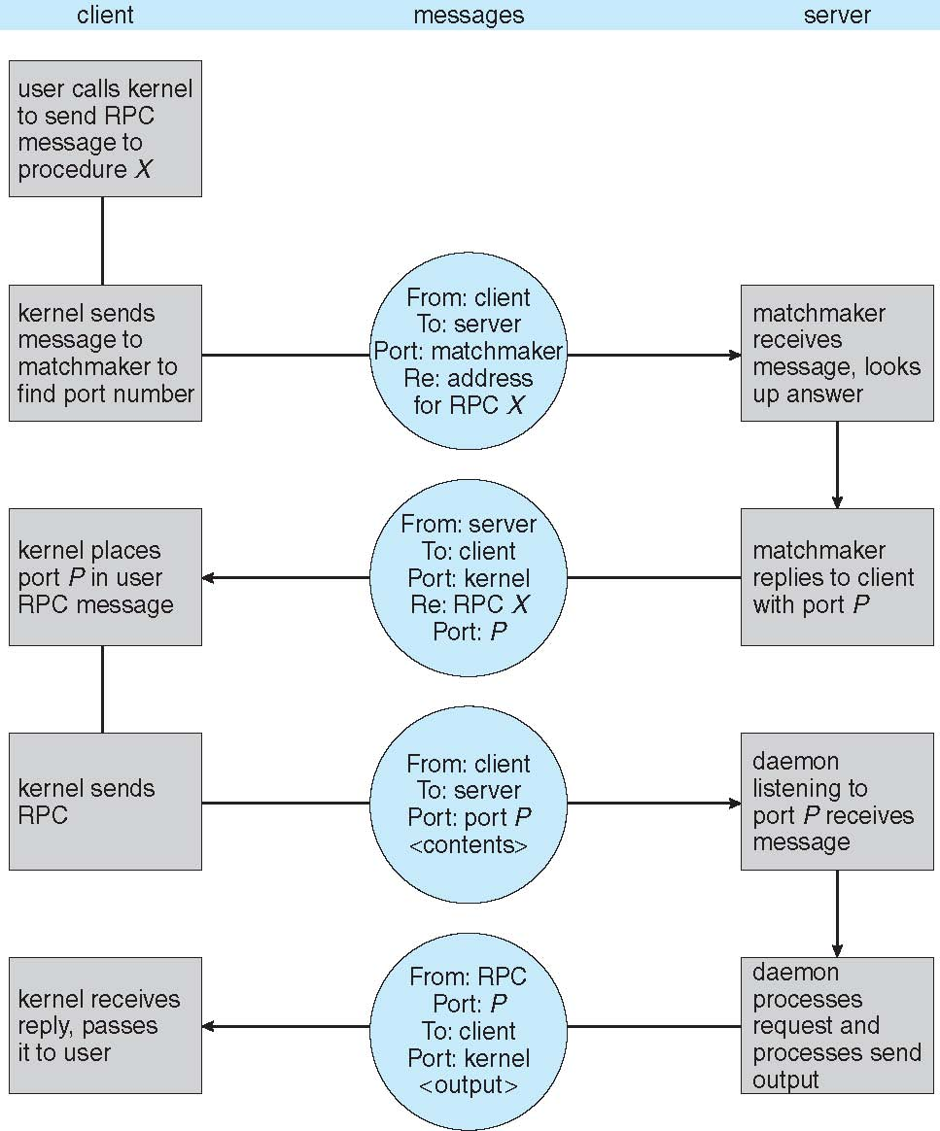
Execution of RPC

Slide 60
Pipes
Acts as a conduit allowing two processes to communicate
Issues:
Is communication unidirectional or bidirectional?
In the case of two-way communication, is it half or full-duplex?
Must there exist a relationship (i.e., parent-child) between the communicating processes?
Can the pipes be used over a network?
Ordinary pipes – cannot be accessed from outside the process that created it. Typically, a parent process creates a pipe and uses it to communicate with a child process that it created.
Named pipes – can be accessed without a parent-child relationship.

Slide 61
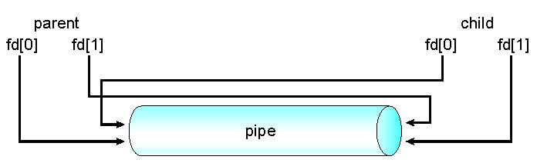
Ordinary Pipes
Ordinary Pipes allow communication in standard producer-consumer style
Producer writes to one end (the write-end of the pipe)
Consumer reads from the other end (the read-end of the pipe)
Ordinary pipes are therefore unidirectional
Require parent-child relationship between communicating processes
Windows calls these anonymous pipes
See Unix and Windows code samples in textbook

Slide 62
Named Pipes
Named Pipes are more powerful than ordinary pipes
Communication is bidirectional
No parent-child relationship is necessary between the communicating processes
Several processes can use the named pipe for communication
Provided on both UNIX and Windows systems

Slide 63

Priority Inversion
Consider the Mars Pathfinder
It had three subsystems
A data-distribution system (High Prio)
A Communication system (Med Prio)
A meteorological data gathering (Low Prio)
There was also a common hardware subsystem:
The data bus used by Task 1 and 3.
It is protected by a semaphore
N A S A/J P L-Caltech
Question: What can happen?

Slide 64
Priority Inversion
Consider the Mars Pathfinder
It had three subsystems
A data-distribution system (High Prio)
A Communication system (Med Prio)
A meteorological data gathering (Low Prio)
There was also a common hardware subsystem:
The data bus used by Task 1 and 3.
It is protected by a semaphore
N A S A/J P L-Caltech
Question: What can happen?
Imagine the following scenario: (1) Low Prio task takes mutex, (2) gets interrupted by Med Prio task, (3) which is interrupted by High Prio task (which blocks because Low Prio task holds lock) Medium Prio task runs even though there is a High Prio task to run (priority is inverted)
Notes:
Image from: http://astronomyonline.org/SolarSystem/Images/Mars/SpiritOpportunity.jpg

Slide 65
Priority Inversion
Several methods to solve priority inversion
Disable all interrupts while in the critical region
Priority ceiling: associate a priority with the mutex and assign that to the process holding it
Priority inheritance: A low-priority task holding the mutex temporarily inherits the priority of the high-priority task trying to obtain it
Random boosting: randomly assigning mutex-holding threads a high priority until they exit the critical region
Notes:
Image from: http://astronomyonline.org/SolarSystem/Images/Mars/SpiritOpportunity.jpg

Slide 66
Modern Operating Systems
Fifth Edition
Chapter 2
Synchronization and Inter-Process Communication - End
Copyright © 2023, 2014, 2008 Pearson Education, Inc. All Rights Reserved
Notes:
If this PowerPoint presentation contains mathematical equations, you may need to check that your computer has the following installed:
1) MathType Plugin
2) Math Player (free versions available)
3) NVDA Reader (free versions available)

